Slide 1

Before the revolution it was hard to be a runner because it wasn’t considered acceptable. Almost no one ran after high school or college.
“People often went out of their way to mock runners. Drivers would slow down and honk their horns. “Get a horse!” They’d yell throwing a beer can or soda at the runner’s head”
- Phil Knight, Shoe Dog

Slide 2
In 1963 Bill Bowerman created running clubs in Eugene that got everyday people running daily . This new found hobby made people think of running as normal.
“A new and healthful passion, commonplace this past year among the men of Eugene, finally has hit their womenfolk. They’re running all over the place, several dozens of them so far following the healthy foot steps of an estimated 1,500 to 3,000 men who are jogging almost daily” - Ann Sullivan (Oregonian, 1965)

Slide 3
In the 1960s people would run in uncomfortable dress shoes. Nike saw that the running craze had begun and capitalized by making running shoes with more cushion and more traction. Running became easier and better for your feet. Thus the demand for running shoe increased further and Nike doubled their yearly sales annually for almost a decade.

Slide 4
The “Butte to Butte” is a community race in Eugene, OR that is one of the oldest races in America. It was started in 1973 by original Nike employee, Geoff Hollister. The Oregon Track Club also has had an important role in the success of the race. They made the race for everyone with a 4 ½ mile walk for older participants, a 5K for families, and prize money for the winners. The Butte to Butte was and is a great family race to get people jogging.

Slide 5
Bill Bowerman’s book, Jogging, was published in 1967. This book got people running.
“… That silly book about jogging, was done, and out in bookstores. A slight 100 pages, Jogging, preached the gospel of physical exercise to a nation that had never heard that sermon before … Somehow, the book caught fire. It sold a million copies, sparked a movement, changed the very meaning of the word ‘running’. Before long, thanks to Bowerman and his book, running was no longer just for weirdos. It was no longer a cult. It was almost... cool.”
- Phil Knight, Shoe Dog

Slide 6
Today people often run for their health. Doctors now suggest that everyone regularly gets moderate to vigorous exercise.
“In a 2014 issue of the Journal of American College of Cardiology”, Lee studied 55,137 adults … and compared the mortality risk between runners and nonrunners. Runners had a 45% lower risk of cardiovascular motality and a 3-year increase in life expectancy over nonrunners during a 15 year follow-up.” - S. Robert Lathan, MD 2023

Slide 7
Before the running revolution, girls track did not even exist. Today, it is the most popular girls high school sport and second on the boys side. Bowerman Track Club in Portland, OR is one of the best youth track clubs in the nation.

Slide 8
Today there are many community races. Almost every weekend you could find 5K or other distance race. There are many races that are associated with holidays, like Turkey Trots, Halloween Dash Bashes, or Shamrock Runs. They are part of community traditions and neighborhood get-togethers.

Slide 10
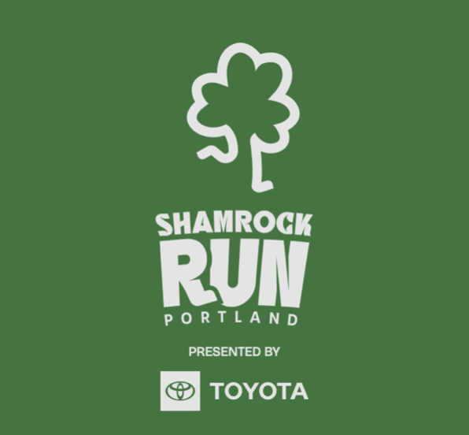
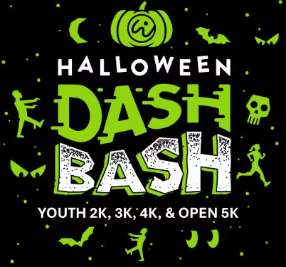
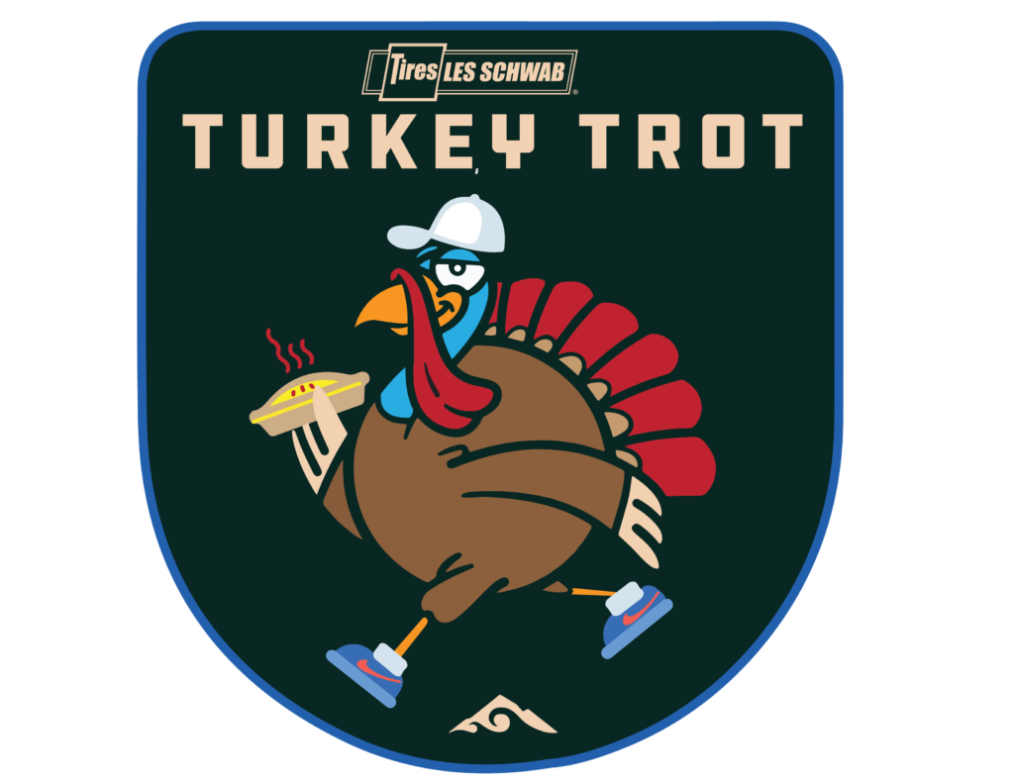

Slide 11
Before the Revolution
Bowerman’s Running Clubs Kickstart a Revolution
A Short Biography of Bill Bowerman
The Book that Got America Running
Nike Capitalizes

